Slide 1

HealthPulse
Kiosk
Health for Everyone
Team: COLOSSUS SQUAD
Done by:
1. Amruthamsh A
2. Amit Kumar Singh
3. Aniverthy Amrutesh
Institution: Dr. Ambedkar Institute of Technology
Dayananda Sagar College of Engineering

Slide 2
Problem Statement
"How might we develop a healthcare system for rural and remote areas that delivers accurate, rapid, and hassle-free diagnostic reports, ensuring convenience and reliability for users?"
Key Points
Rural Accessibility: Create a healthcare system specifically designed for rural and remote areas where access to medical facilities is often limited or non-existent.
Accuracy: Ensure the system delivers precise and reliable diagnostic reports through advanced sensors and data analysis techniques.
Speed: Implement mechanisms to provide rapid diagnostic results, reducing the waiting time for users and enabling timely medical intervention.
User Convenience: Design an intuitive and user-friendly interface that makes the process of obtaining diagnostic reports straightforward and hassle-free.
Reliability in Basic Environments: Guarantee consistent and dependable operation of the healthcare system, even in environments lacking basic facilities and internet connectivity, to ensure continuous service availability.

Slide 3
Market Size and Statistics
Health Disparities in Rural and Remote Areas
Population Affected:
Over 3.4 billion people live in rural areas globally.
Approximately 70% of India's population resides in rural areas with limited healthcare facilities.
Healthcare Access Issues:
Shortage of medical facilities and healthcare professionals.
Long travel distances to access basic medical care, leading to delayed treatments.
Prevalence of Health Issues:
Higher prevalence of chronic diseases such as hypertension, diabetes, and heart conditions.
Increased maternal and infant mortality rates due to inadequate prenatal and postnatal care.
Market Potential for Health Monitoring Kiosks
Global Market Size:
The global telehealth market is projected to reach USD 559.52 billion by 2027, growing at a CAGR of 25.2% from 2020 to 2027.
Target Market:
Focus on rural and remote populations in developing countries like India, Africa, and parts of Southeast Asia.
Governments and NGOs investing in telehealth solutions to improve rural healthcare infrastructure.
Adoption Rate:
Increasing acceptance of technology in rural areas with rising smartphone and internet penetration.
Successful pilot projects and case studies demonstrating efficacy and acceptance.
Cost-Effectiveness:
Health kiosks offer a cost-effective solution for continuous health monitoring.
Reduces the burden on overstrained rural healthcare systems and provides timely medical interventions.

Slide 4
Proposed Solution
The HealthPulse Kiosk is designed to provide comprehensive health monitoring in rural and remote areas. This innovative kiosk integrates various sensors and machine learning models to ensure accurate, real-time health diagnostics and predictions. The kiosk aims to bridge the healthcare access gap by offering a reliable, user-friendly solution.
Display Interface:
Tablet or display screen showing the "Healthcare Monitoring System" interface.
Displays real-time ECG readings, oximeter readings (pulse rate and oxygen saturation), temperature, and GSR values (stress/anxiety levels).
Sensor Integration:
Lower section contains various sensors connected via wires.
Sensors include ECG sensor, GSR sensor, pulse oximeter, and temperature sensor for collecting vital health data.
ESP32 Module:
Used for transmitting collected data to a central database (Google Sheets).
Runs the deployed machine learning model (EasyTiny module).
Data Processing and Visualization:
Data uploaded to Google Sheets for storage and training the machine learning model.
Machine learning model predicts health metrics in real-time.
Results and ECG graph are displayed on the interface, providing visual insights into the user's health.

Slide 5
Innovation/Uniqueness you Claim
Here are five unique features of the low-cost health pulse kiosks:
Offline Functionality with ESP32 Soft Access Point: The kiosks utilize ESP32 microcontrollers with a soft access point, allowing them to function without an internet connection, making them highly suitable for remote and rural areas with limited connectivity.
Innovative Stress Detection: The kiosks are equipped with sensors to measure skin conductivity, providing an innovative method for detecting stress levels in users, which can be crucial for mental health monitoring.
Email Diagnosis Delivery: After performing tests and diagnostics, the kiosks can send the results directly to the user's email, ensuring that users have a digital record of their health assessments for future reference.
Emergency Video Call with Doctor*: In emergency situations, the kiosks enable users to initiate a video call with a doctor, providing immediate access to medical advice and support when needed.
Multi-Functional Health Monitoring: The kiosks offer a range of health monitoring services, including blood pressure measurement, temperature monitoring, pulse monitoring, blood oxygen levels, and other basic diagnostics, providing comprehensive health assessments in one device.

Slide 6
Impact on the Society
Here are five key societal impacts of deploying innovative low-cost health pulse kiosks:
Enhanced Healthcare Accessibility: The kiosks bring essential healthcare services to remote and underserved areas, improving access to medical care and reducing the need for long-distance travel to healthcare facilities.
Improved Health Outcomes: By enabling regular monitoring and timely diagnosis, the kiosks help manage chronic conditions and detect health issues early, leading to better health outcomes and reduced morbidity rates.
Cost Reduction in Healthcare: These kiosks lower healthcare costs by reducing travel expenses, hospital visits, and emergency care needs, making healthcare more affordable for low-income populations.
Support for Mental Health: The stress detection feature helps identify and address mental health issues early, promoting mental well-being and reducing the stigma associated with mental health conditions.
Emergency Medical Assistance: The video call capability with doctors in emergencies ensures that users have access to immediate medical advice, potentially saving lives and improving emergency response times in rural areas.

Slide 7
Business Scalability Justification
Business scalability justification for low-cost health pulse kiosks:
High Market Demand and Growth: Rising healthcare needs, telehealth market expansion, and supportive government initiatives create a strong demand for health kiosks in rural areas.
Cost-Effectiveness: Affordable setup and maintenance costs, along with reduced healthcare expenses due to minimized in-person visits and hospital readmissions, make kiosks financially viable for widespread deployment.
Technological Advancements: Integration with IoT, AI, and scalable software solutions enhances functionality and ensures smooth expansion and interoperability with existing healthcare systems.
Improved Healthcare Access: Health kiosks bridge the healthcare gap in remote areas, providing essential services and supporting local healthcare workers, thereby improving overall healthcare accessibility and efficiency.
Strategic Partnerships and Funding: Collaborations with governments, NGOs, and healthcare organizations, along with access to grants and subsidies, facilitate deployment and scaling efforts.
Sustainability and Continuous Improvement: Modular design, renewable energy sources, and data-driven insights ensure the long-term viability, adaptability, and continuous enhancement of health kiosks.

Slide 8
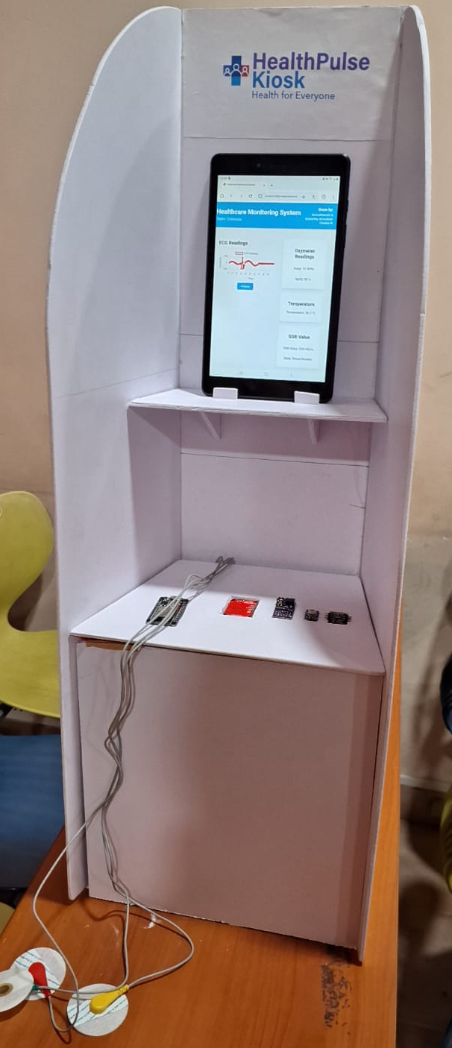
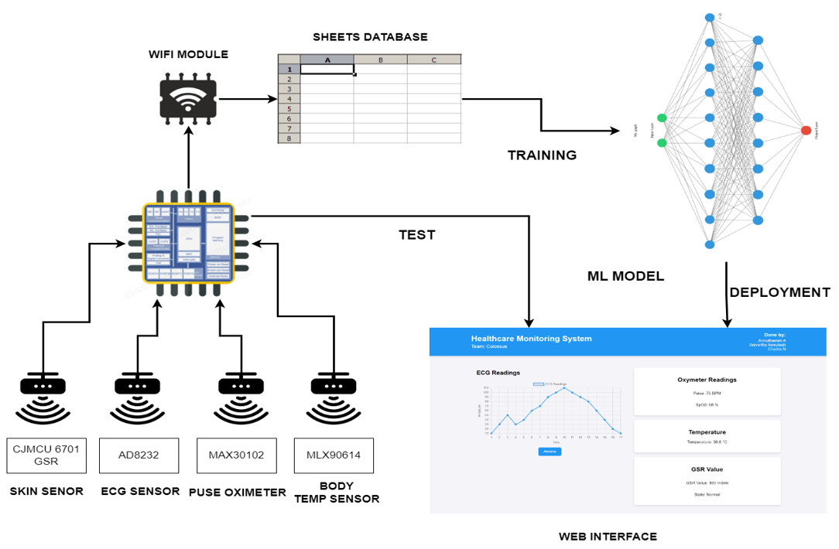
Prototype & Its current level (if any)
DATA FLOW DIAGRAM

Slide 9
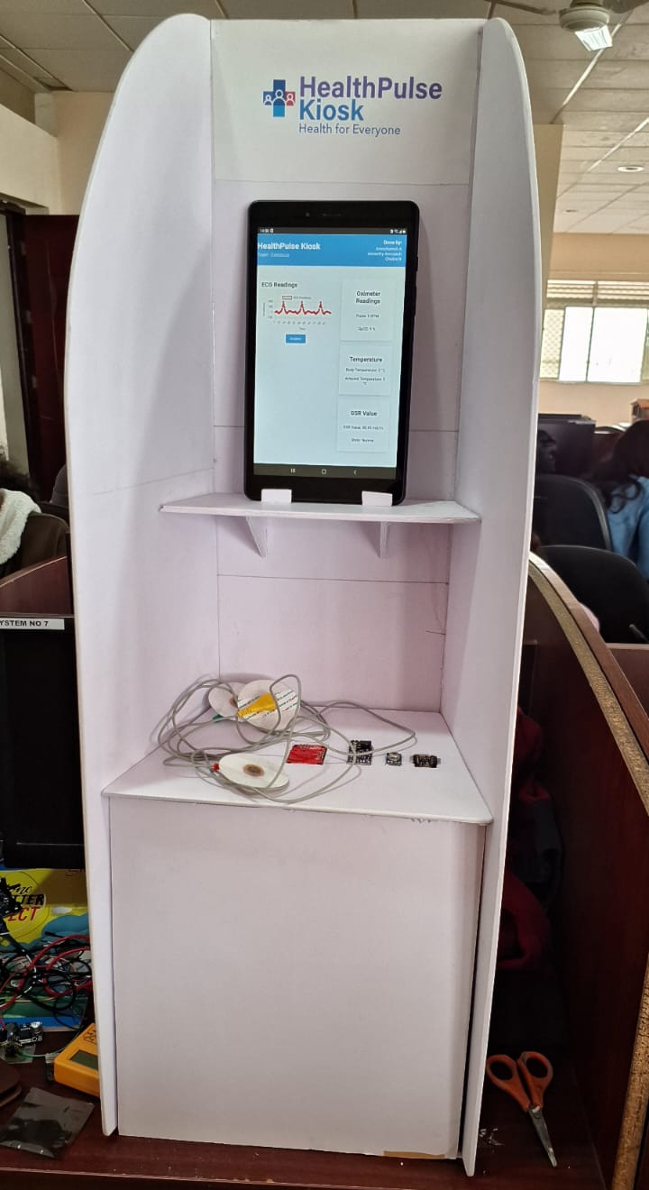
Prototype Overview
Data Collection: Inputs are taken from sensors (ECG, GSR, pulse oximeter, temperature) via ESP32.
Data Upload: Sensor data is uploaded to Google Docs through ESP32 for centralized storage.
ML Model Training: Collected data is used to train the machine learning model using the EasyTiny module in ESP32.
Real-Time Prediction: Sensor values are fed into the deployed ML model, making real-time predictions.
Data Visualization: Predicted values and ECG graphs are displayed on a website interface.
GitHub Link: https://github.com/Aniverthy/HealthPulse-Kiosk
Prototype

Slide 10
Strategy and Business Model
Business Model
Revenue Streams:
Subscription Model: Offer subscription plans for individuals and families to access regular health monitoring services.
Government and NGO Funding: Secure funding from government health initiatives and NGOs focused on rural healthcare.
Corporate Sponsorships: Partner with corporate entities for sponsorship and CSR (Corporate Social Responsibility) funding.
Fee-for-Service: Charge a nominal fee for each health check-up and diagnostic service provided by the kiosk.
Cost Structure:
Initial Setup Costs: Investment in hardware (sensors, ESP32 modules, display units) and software development.
Operational Costs: Maintenance of kiosks, data storage, and technical support.
Training and Outreach Costs: Expenses related to training local health workers and conducting awareness campaigns.
Scalability:
Modular Design: Use a modular design for kiosks to easily scale and adapt to different regions and requirements.
Franchise Model: Expand through a franchise model, allowing local entrepreneurs to operate kiosks under the HealthPulse brand.
Technology Upgrades: Continuously upgrade technology and software to enhance service quality and efficiency.
Impact Measurement:
Health Outcomes: Track improvements in health outcomes and access to healthcare services in target areas.
User Feedback: Regularly collect and analyze user feedback to improve services and address any issues.
Sustainability Metrics: Monitor the financial sustainability and scalability of the business model.

Slide 11
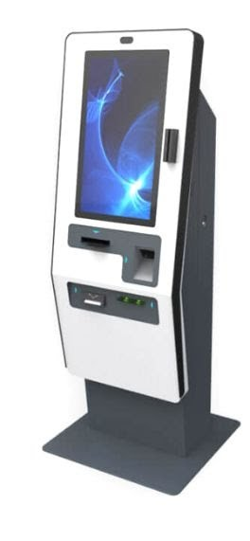
Strategy and Business Model
Strategy
Target Market:
Focus on rural and remote areas with limited access to healthcare facilities.
Collaborate with local governments, NGOs, and healthcare organizations to deploy kiosks in underserved regions.
Partnerships and Collaborations:
Partner with healthcare providers for medical oversight and support.
Collaborate with technology companies for sensor and software integration.
Technology Integration:
Utilize advanced sensors and machine learning models to ensure accurate health monitoring.
Ensure seamless data transmission and real-time analysis using ESP32 and cloud-based storage.
User Training and Support:
Provide training programs for local health workers to operate and maintain the kiosks.
Offer continuous technical support and updates to ensure smooth operation.
Awareness and Outreach:
Conduct awareness campaigns to educate the target population about the benefits of health monitoring kiosks.
Use local media and community events to promote the kiosk and its services.

Slide 12


